Slide 1

Residential building price
prediction
DSA5101
Cai Yusen A0251268A
Deng Yiyang A0251343N
Liu Boyu A0177847J
Liu Yu A0177906R
Notes:
Hello professor, this is Group 15. Today's topic is about how machine learning models help the bank select high value clients.

Slide 2
Content
1
Overview of the Business Problem
2
Data Analysis
3
Sale Price Prediction
4
Recommendations

Slide 3


Overview of the Business Problem

Slide 4
01
Overview of the Business Problem
Problem Statement
Housing market is tightly connected with the state of economy in general. For example, the precursor to the recent global economic crisis was the bust in the real estate market. Predicting building sales price is a crucial step for construction companies and investors in supporting budget assignment, finding property financing stratagems and deciding appropriate arrangements. However, the stakeholders involved might be unaware of the statistical techniques available to predict the building sales price, which could facilitate their investment decision.
This presentation making use of data science analysis techniques to find out the driving factors of building sales price. Through understanding impacts and correlation of different factors, building models to predict the sales price, the necessary of the construction investment can be determined.

Slide 5
01
Overview of the Business Problem
Stakeholders
Our stakeholders are construction companies and investors.
The purpose is to build a model that can be used by stakeholders to gauge the sale market before they start a new construction and decide whether to build.

Slide 6
01
Overview of the Business Problem
Summary of Project
Methods
The provided data set includes several factors related to the single-family residential apartments in Tehran, Iran. Through analyzing the data to understand the drivers and their impacts on sales price, a linear regression model is built to predict the housing price.
Deliverables
We managed to build a regression model with high interpretability and prediction accuracy which can help construction companies to make wise decisions.

Slide 7
01
Overview of the Business Problem
Business Benefits
Stakeholders could understand the feasibility of the construction project and reduce the risk of investments.
In a down market, the builder may decide to postpone the beginning of construction.
In an up market, the builder may prefer to sell the units at the time of completion instead of the presale to maximize the profit.
A construction company with multiple projects in different regions can use the tool for resource scheduling and allocation.
For example, they can allocate large cranes to localities with a better price prospect.

Slide 8
01
Overview of the Business Problem
Summary of Project
Team capabilities:
Business analyst: Deng Yiyang, Cai Yusen, Liu Yu
Data scientist: Cai Yusen, Deng Yiyang, Liu Boyu
Code Reviewer: Cai Yusen, Deng Yiyang

Slide 9
Data Analysis

Slide 10
02
Data Analysis
Basic Information of the Dataset
The dataset has 372 samples and 29 variables.
No null and duplicate values.
The variables can be divided into two parts below:
Physical and financial factors about the single-family residential apartments in Tehran, Iran.
Economic indicators and indices.

Slide 11
02
Data Analysis
Variables Type
Output: Actual Sales Prices (V.9)
Unordered categorical variables:
Project locality (V.1), Type of residential building (V.10)
Ordinal categorical variable:
The interest rate for loan in a time resolution (V.20)
The interest rate is a numerical variable based on its meaning. However, since it only has 4 values, we consider it as an ordinal categorical variable.
Numerical variables: Others

Slide 12
02
Data Analysis
Actual Sales Price
mean | 1387.4
std | 1206.1
min | 50
25% | 577.5
50% | 1000
75% | 1700
max | 6800

Slide 13
02
Data Analysis
Actual Sales Price
The distribution of actual sales price is unsymmetric. From the histogram and the table, we can find that prices are concentrated in the range from 50 to 2000.

Slide 14
02
Data Analysis
Who affects Actual Sales Price?

Slide 15
02
Data Analysis
Locality
Type | 1 | 2
V.1 | 193 | 179
It shows that the number of apartments in different localities is similar.

Slide 16
02
Data Analysis
Locality
Purpose: Determine whether the locality actually has an effect on the sales price.
Statistical Test: T-test
H0: Sales prices in two locality are not significantly different.
Result: t = 8.749, df = 245.1, p-value = 3.532e-16
Conclusion: Locality has influence on the sales price. Apartments in locality 1 are more expensive.

Slide 17
02
Data Analysis
Building Type
Type | 1 | 2 | 3 | 4
V.10 | 55 | 129 | 133 | 55
Most of the apartments belong to type 2 and 3.

Slide 18
02
Data Analysis
Building Type
Purpose: Determine whether the building type actually has an effect on the sales price.
Statistical Test: ANOVA test
H0: Sales Price stays the same under different Building Type.
Result: df = 3, F = 90.6, p-value < 2e-16
Conclusion: Building type has influence on the sales price, which increases from type 1 to type 4.

Slide 19
02
Data Analysis
Loan Interest Rate
Type | 11 | 12 | 14 | 15
V.20 | 66 | 8 | 58 | 240
Usually, the interest rate for loan is 15%, while 12% in rare case.
Changes in interest rates can sensitively reflect the supply and demand of funds in the financial market.

Slide 20
02
Data Analysis
Loan Interest Rate
Purpose: Determine whether the interest rate for loan has an effect on the sales price.
Statistical Test: ANOVA test
H0: Sales Price stays the same under different Loan Interest
Result: df = 3, F = 36.13, p-value < 2e-16
Conclusion: The higher the interest rate, the lower the price. There are few samples with interest rate equal to 12 so that the corresponding price distribution is special.

Slide 21
02
Data Analysis
Preliminary Estimated Construction Cost
Statistical Test: T test
H0: Preliminary Estimated Construction Cost has no influence on Sales Price
Result: t = 24.373, p-value < 2e-16
Conclusion: Preliminary Estimated Construction Cost has influence on Sales Price. As it increases, the sales price will be higher as well. Precisely, their linear association is more obvious when the construction costs are relatively low.

Slide 22
02
Data Analysis
Price of the unit at the beginning
Statistical Test: T test
H0: Price of the unit at the beginning has no influence on Sales Price
Result: t = 87.023, p-value < 2e-16
Conclusion: Price of the unit at beginning has influence on Sales Price. Also, the adjusted R square hits 0.9533, which means only this variable explain over 95.33% of the variance of the Sales Price.

Slide 23
02
Data Analysis
Is there redundancy in variables?

Slide 24
02
Data Analysis
Locality VS Building Type
V.1 V.10 | 1 | 2
1 | 16 | 39
2 | 57 | 72
3 | 75 | 58
4 | 45 | 10
Purpose: Since these two variables both have influence on price, we test their relationship.
Statistical Test: Chi-square test
H0: Locality and Building Type are independent.
Result: df = 3, X-square = 35.33, p-value =1.037e-07
Conclusion: The locality and building type are dependent.

Slide 25
02
Data Analysis
Numerical Variables
There are 25 numerical variables. The most obvious feature is the high correlation between variables which means we have to deal with collinearity when building a model.

Slide 26
02
Data Analysis
Official exchange rate with respect to dollars
mean | 5934.19
std | 3543.38
min | 1591.75
25% | 1755
50% | 8209.9
75% | 9137.91
max | 9967.33
The distribution of official exchange rate is relatively sparse.

Slide 27
02
Data Analysis
Cost at different Phases
 | Completion Cost | Beginning Cost
mean | 1327.5 | 1466.3
std | 868.5 | 957.2
min | 170.3 | 211.1
25% | 641.5 | 744.5
50% | 1023.7 | 1203.3
75% | 1994.6 | 2025
max | 4188.6 | 4741.6

Slide 28
02
Data Analysis
Cost at different Phases
(V.21 and V.22)
They are the average of construction cost of buildings by private sector at the time of completion and beginning respectively. It shows that their distributions are similar and totally the average of cost is more expansive at the beginning than the end.

Slide 29
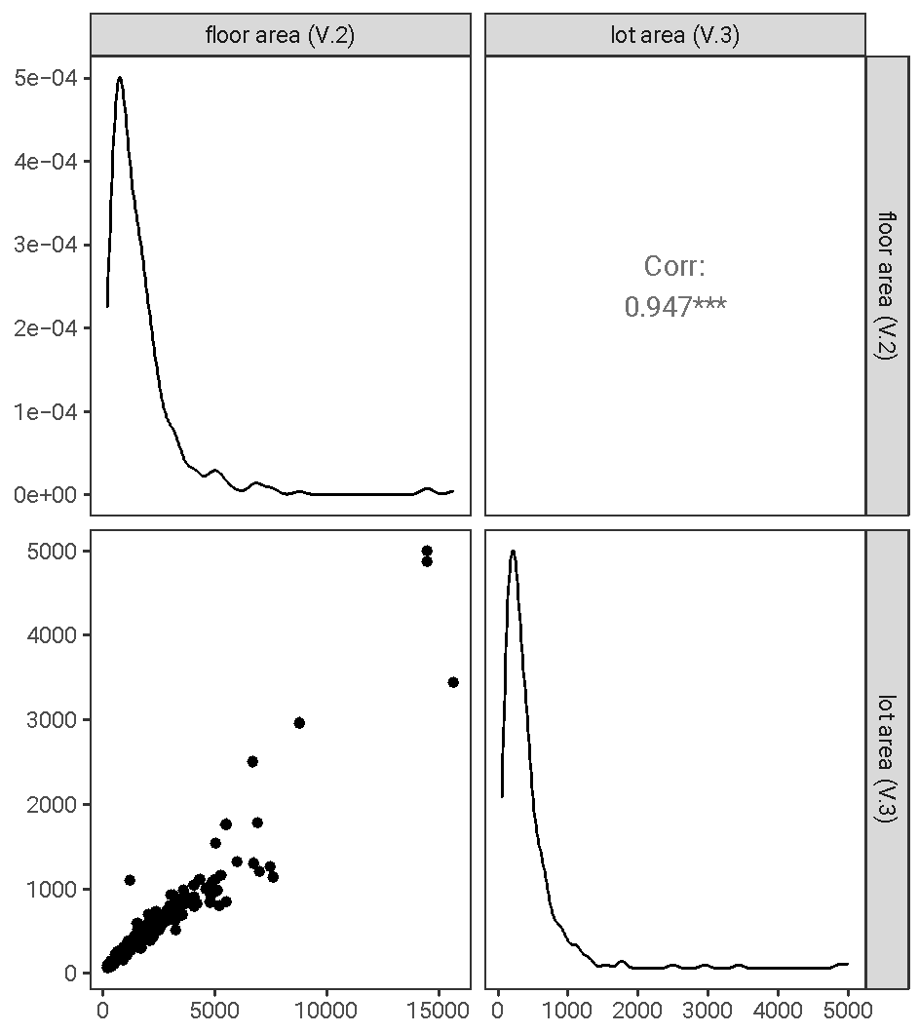
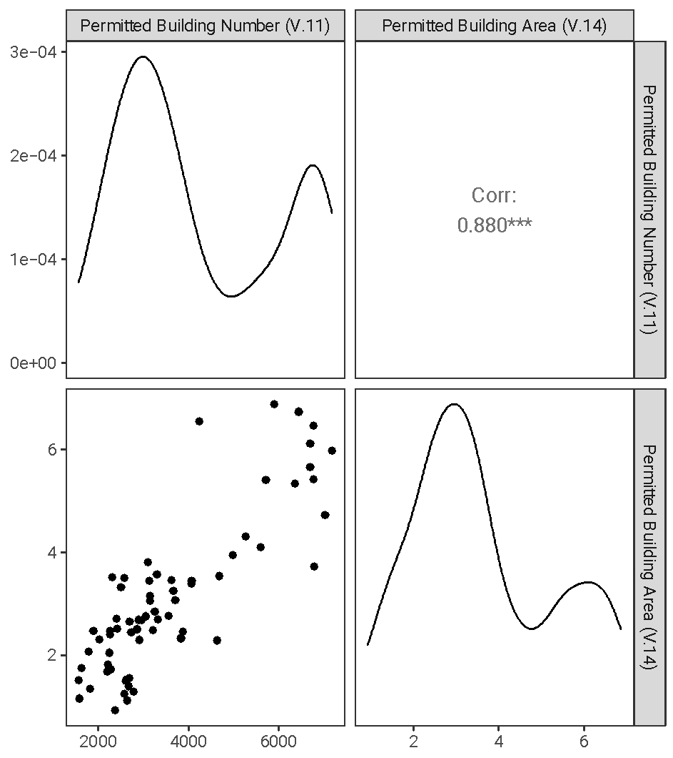
02
Data Analysis
Correlations between two variables
There are two positive correlated groups: floor area and lot area, permitted building number and permitted building area. The correlation coefficient both achieve above 0.88.

Slide 30
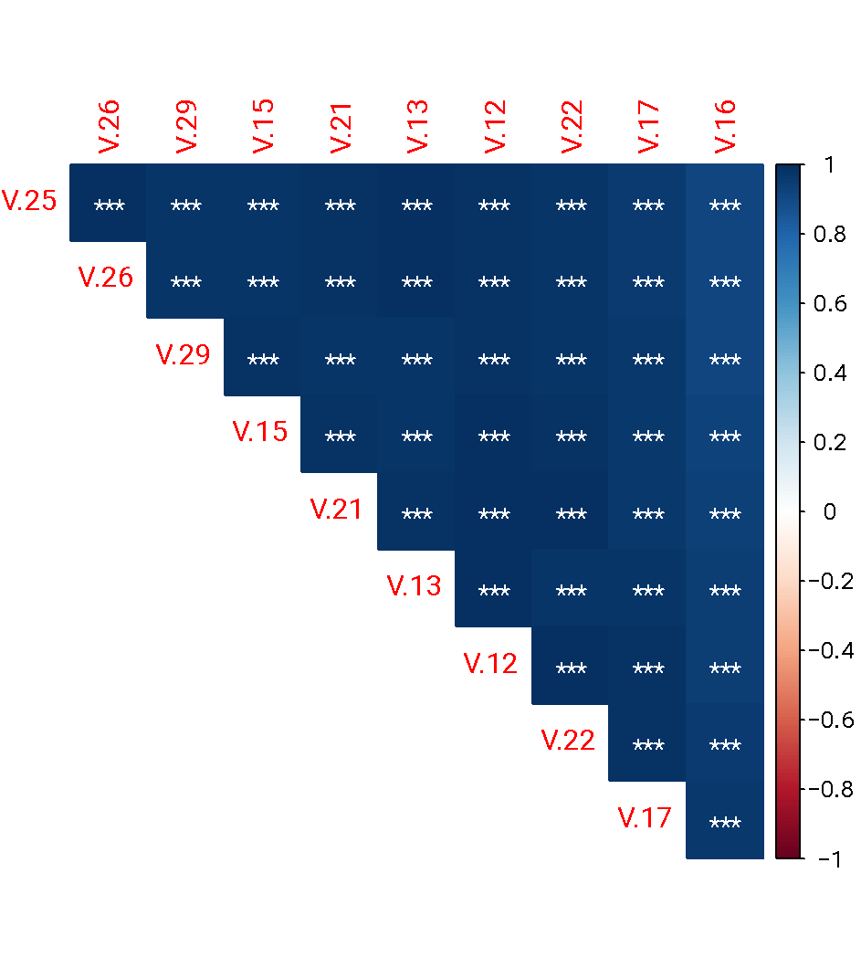
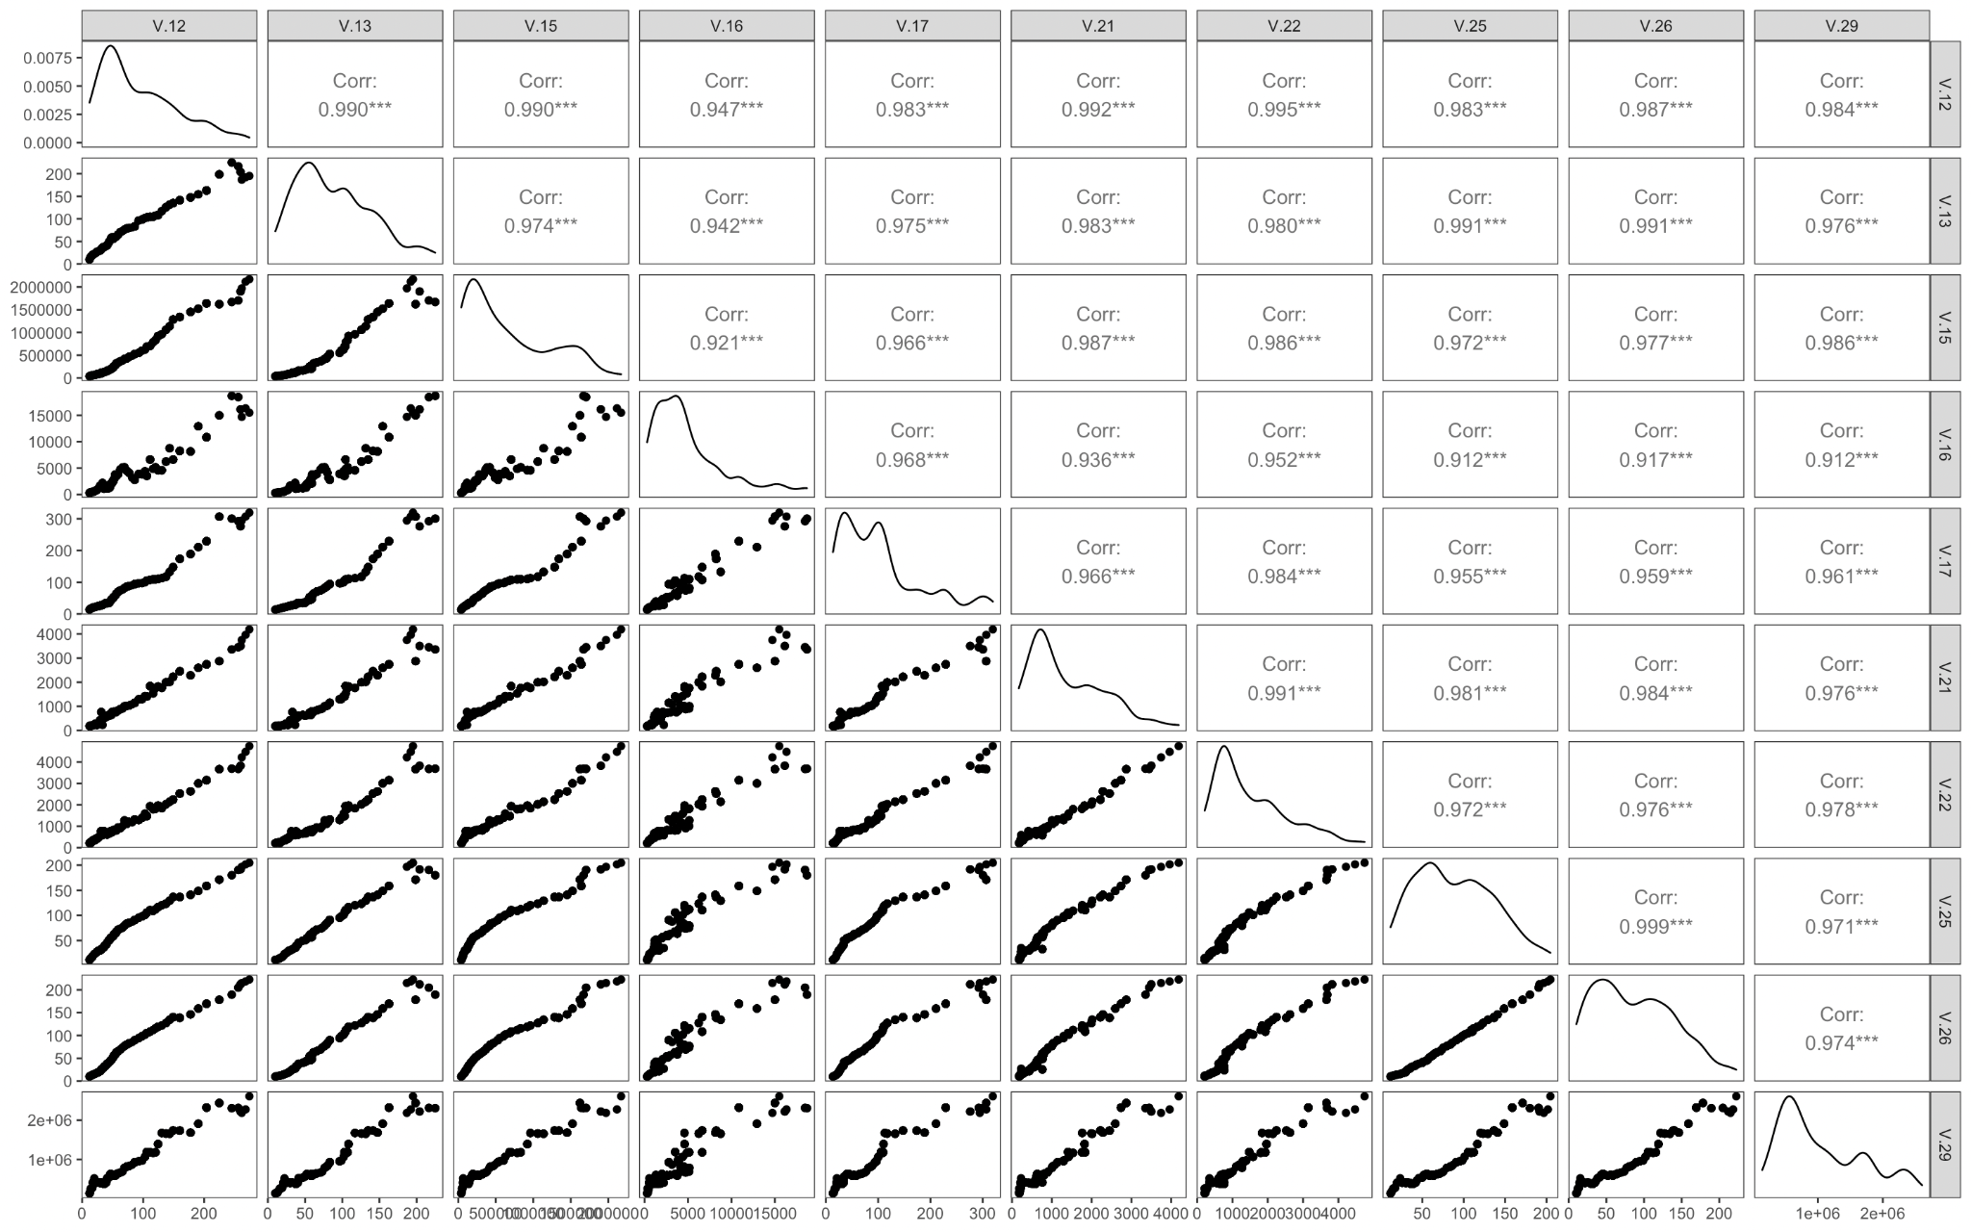
02
Data Analysis
Correlations among several variables

Slide 31
02
Data Analysis
Correlations among several variables
One of the characteristics of this dataset is the high correlation between variables. From the pairwise plot and heatmap plot, we can conclude that any two of V.12, 13, 15, 16, 17, 21, 22, 25, 26, 29 are positively correlated. This will cause collinearity when building a model. Thus, we have to remove some variables or perform an analysis designed for highly correlated variables, such as PCA.

Slide 32
Sale Price Prediction

Slide 33
03
Sale Price Prediction
Linear regression model
Build a linear regression model with high interpretability and prediction accuracy.
Considering the fact that some variables are highly correlated as concluded in the data analysis section, we remove variables whose correlation coefficient is larger than 0.85.

Slide 34
03
Sale Price Prediction
Final model
variable | coefficient | variable | coefficient
Locality 2 | -101.8 | The amount of loans | 0.007 (***)
Total estimated construction cost | 0.154(**) | The interest rate equal to 12 | -388.6(**)
Estimated construction cost | -1.72 (***) | The interest rate equal to 14 | -149.3(*)
Estimated construction cost in a base year | 0.165(*) | Private sector investment in new buildings | -0.056 (***)
Duration of construction | 42.56 (***) | The interest rate equal to 15 | -287.3 (***)
Price at the beginning of project | 1.176 (***) | Stock market index | 0.024 (***)
Building Type 4 | 132.5(*) | Population of the city | -0.004
Total floor areas of building permits issued | 27.36(**)
Significant codes : p value of t test 0 ‘***’ 0.001 ‘**’ 0.01 ‘*’

Slide 35
03
Sale Price Prediction
Model explanations
Variables in the table above are all effective drivers of price. The practical meaning of coefficient is the magnitude of the effect of one variable on price. In particular, the interest rate has a negative and relatively great influence on price while the price at the beginning of the project has a significantly positive effect on the actual price.

Slide 36
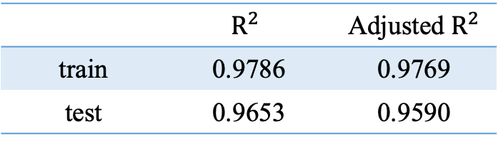
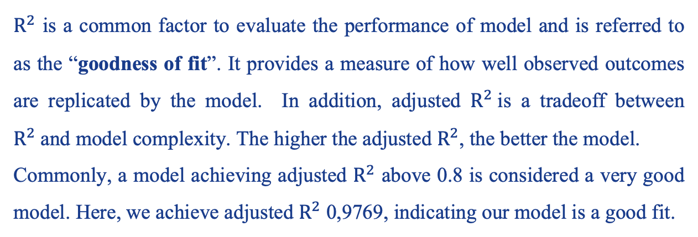
03
Sale Price Prediction
How good our model fits
$R^{2}$ is a common factor to evaluate the performance of model and is referred to as the “goodness of fit”. It provides a measure of how well observed outcomes are replicated by the model. In addition, adjusted $R^{2}$is a tradeoff between $R^{2}$and model complexity. The higher the adjusted $R^{2}$, the better the model.
Commonly, a model achieving adjusted $R^{2}$ above 0.8 is considered a very good model. Here, we achieve adjusted $R^{2}$ 0,9769, indicating our model is a good fit.
 | $$R^{2}$$ | Adjusted $R^{2}$
train | 0.9786 | 0.9769
test | 0.9653 | 0.9590

Slide 37
03
Sale Price Prediction
How accurate our model predicts
Root-Mean-Square error (RMSE) is a frequently used measure of the differences between values predicted by a model and the values observed. It measures how much our predicted value deviate the true value.
Normalized Root-Mean-Square error (NRMSE) is a normalized version of RMSE, which eliminates the influence of the scale. The lower NRMSE is, the more accurate our model predicts. A value of 0 indicates a perfect fit.
Here, we achieve 0.0351 NRMSE, which indicates highly accuracy of our model.
 | RMSE | NRMSE
train | 171.549 | 0.0277
test | 237.230 | 0.0351

Slide 38
Recommendations

Slide 39
04
Recommendations
Recommendations
The actual sales prices can be influenced by several factors and may vary from year to year due to inflation, deflation, or other economic conditions. There are some regularities:
In general there is an inverse relationship between the interest rates and the price.
There are several important drivers that companies and investors should notice including the interest rate, construction cost, duration, price at the beginning of the project, stock market index etc.

Slide 40
THANK YOU

